Slide 1
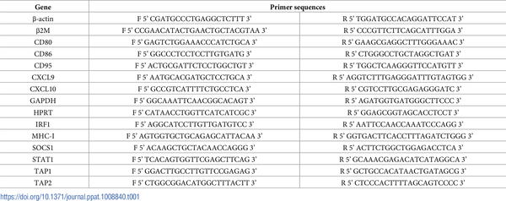
Table 1. qPCR primer sequences.
Hojo-Souza NS, de Azevedo PO, de Castro JT, Teixeira-Carvalho A, Lieberman J, et al. (2020) Contributions of IFN-γ and granulysin to the clearance of Plasmodium yoelii blood stage. PLOS Pathogens 16(9): e1008840. https://doi.org/10.1371/journal.ppat.1008840
https://journals.plos.org/plospathogens/article?id=10.1371/journal.ppat.1008840

